Slide 1

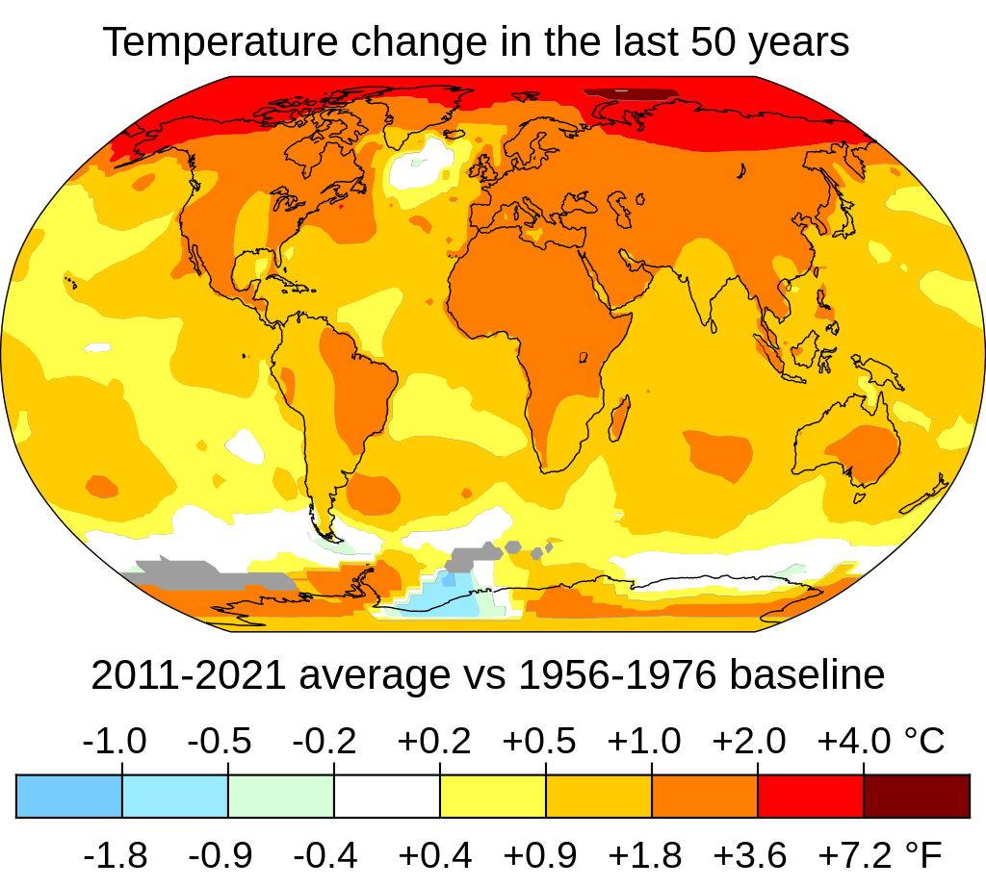
IFC Economics Country Climate & Development Report Workshop
IFC Economics Country Climate & Development Report Workshop
Retrospective & Look Ahead
11 July 2022
Retrospective & Look Ahead
11 July 2022
Source: NASA’s Scientific Visualization Studio

Slide 2
Agenda
Session 1: Retrospective
10:00 | Opening remarks
10:05 | CCDR “Meta-Analysis” of IFC Inputs & CCDR Recommendations
10:10 | IFC Regional Economics Retrospective by Region
10:30 | Q&A
Session 2: Forward Look
10:45 | Tools & Resources Update
10:55 | Development Impact Work Program Update
11:00 | Climate Business Work Program Update
11:05 | Q&A
11:20 | Next Steps
11:30 | Closing remarks

Slide 3
IFC Economics Country Climate & Development Report Workshop
“Meta-Analysis” of IFC Inputs & CCDR Recommendations
Preliminary findings from rapid assessment of substantive IFC Econ inputs to FY22 CCDRs
Retrospective & Look Ahead
11 July 2022

Slide 4
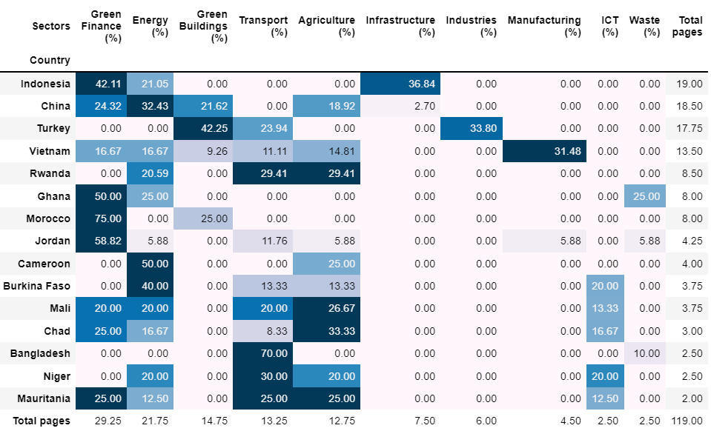
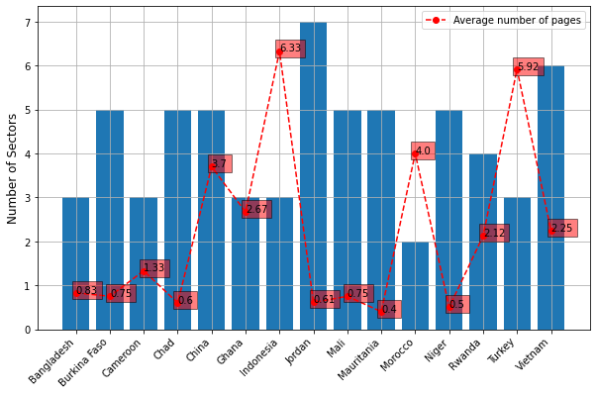
IFC contributions to CCDRs, on average, cover ~4 sectors and provide ~2 pages of mostly qualitative insight, based on preliminary analysis.
Figure 1: Distribution of sectoral coverage (breadth) and average pages contributed (depth) for each country.
Figure 2: Depth of contributions per country, sector.
The average coverage (breadth) of IFC’s contribution to CCDR is 4.2 sectors, and the average written input (depth) is 2.18 pages per sector.
96.8% of contributions are qualitative input, and 12.5% contributions involve some data research.
The most sectoral coverage is seen in Jordan CCDR, and the highest number of pages contributed is in the Indonesia CCDR.
There is a significant negative correlation of 0.54 between sectoral coverage and depth of contributions.
Most contributions are done in Green Finance, Energy, and Green Buildings accounting for 24.6%, 18.3%, and 12.3% of all IFC contributions.
Also, 42.11% of contributions to the Indonesia CCDR were on Green Finance; 32.43% of contributions to the China CCDR were on Energy; and 42.25% of contributions to the Turkey CCDR were on Green Buildings.
Note: Analysis based on substantive written inputs to 15 of 23 CCDRs, as of July 8, 2022.
IFC ECONOMICS CCDR WORKSHOP JULY 2022

Slide 5
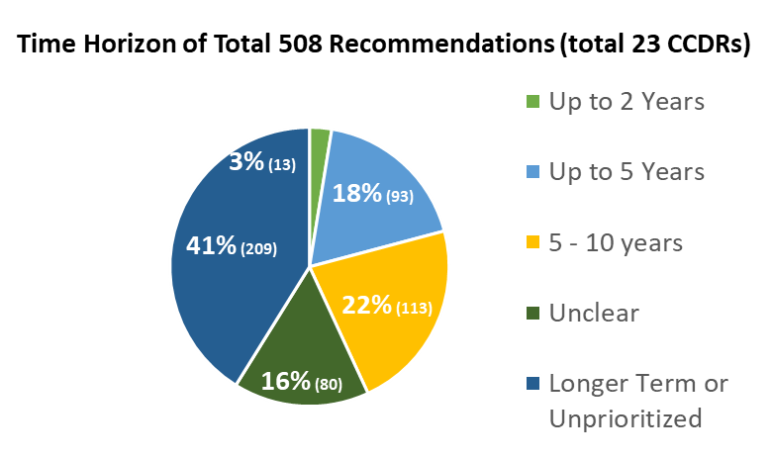
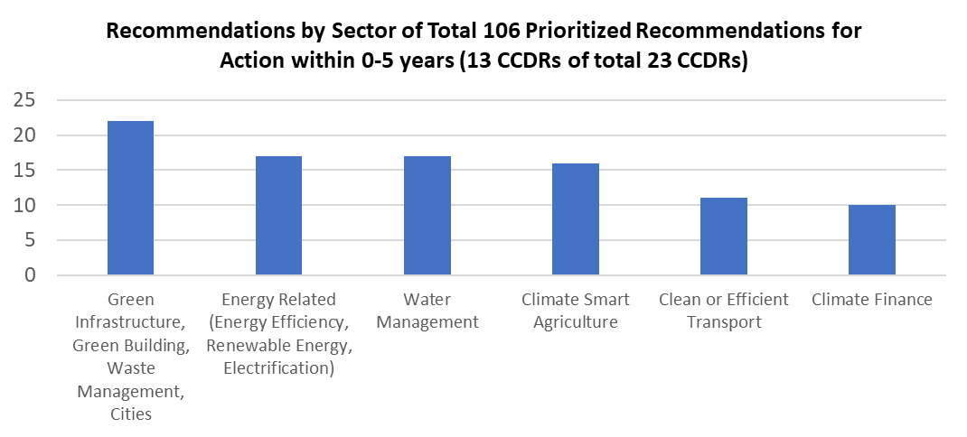
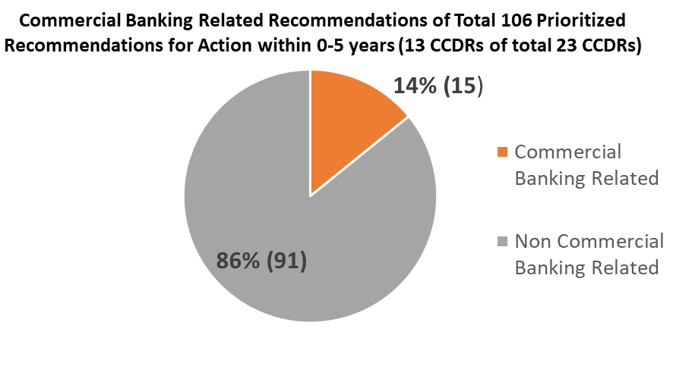
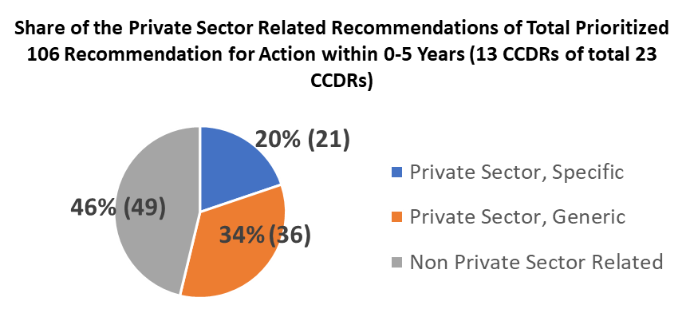
Roughly 10% of CCDR recommendations are focused on near-term, private sector-related issues, based on preliminary analysis.
IFC ECONOMICS CCDR WORKSHOP JULY 2022

Slide 6
IFC Economics Country Climate & Development Report Workshop
Tools & Resources Update
Retrospective & Look Ahead
11 July 2022

Slide 7
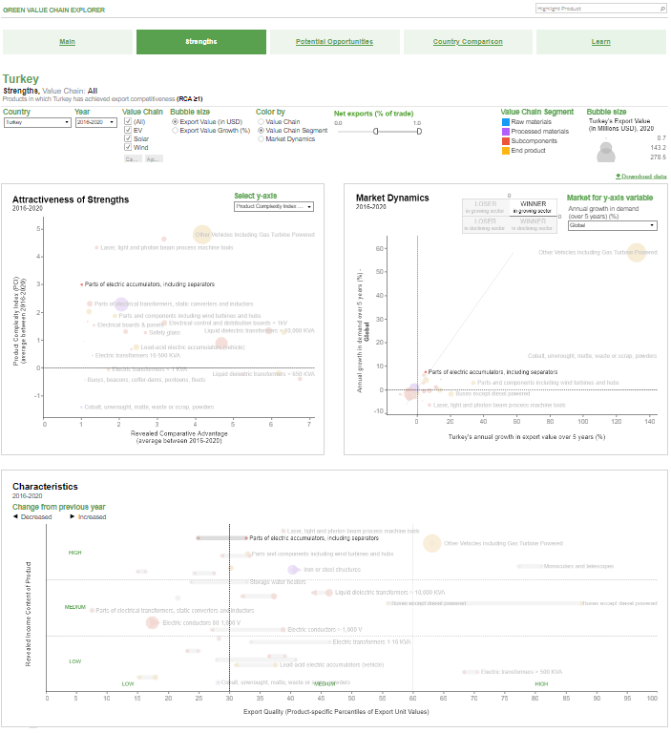
Green Value Chain Explorer
Objective:
Explore countries’ competitive strengths and potential opportunities associated with products in green value chains
Content:
What are countries’ strengths and opportunities in the value chains of wind, solar, electric vehicles? Available for 190+ countries, reflecting latest available annual trade data (BACI, 2020).
How have market shares in these products evolved, both for specific countries and globally?
What are the underlying product characteristics? Is the product established in a country? Where is it positioned in the value chain? Does the country export the product under consideration with high export quality? Is the product technologically sophisticated?
How do a country’s strengths and potential opportunities compare to regional, structural or aspirational peers?
Status:
Finalized; work on adoption side of green products/technologies is now taking place
Explore the tool: gvce/
IFC ECONOMICS CCDR WORKSHOP JULY 2022

Slide 8
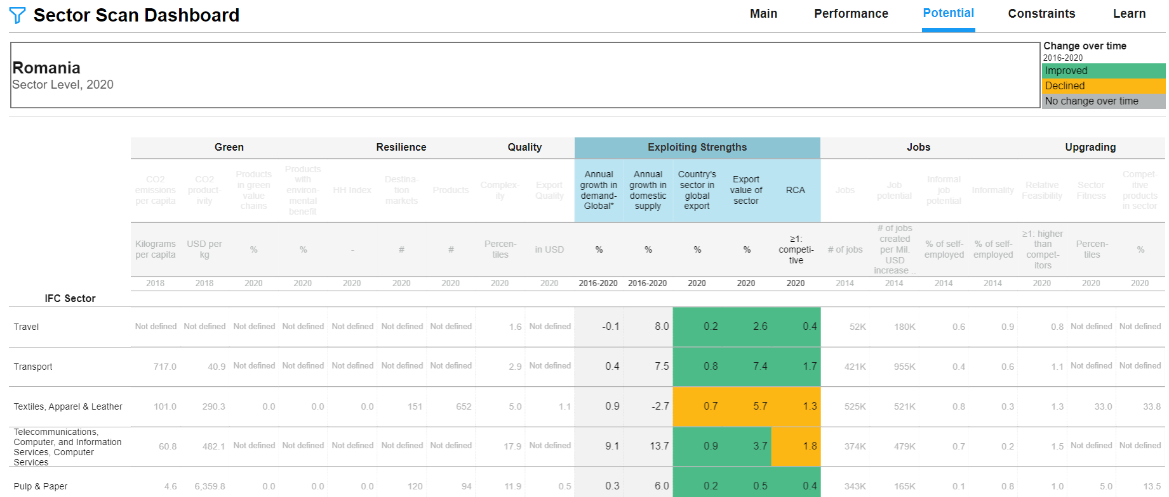
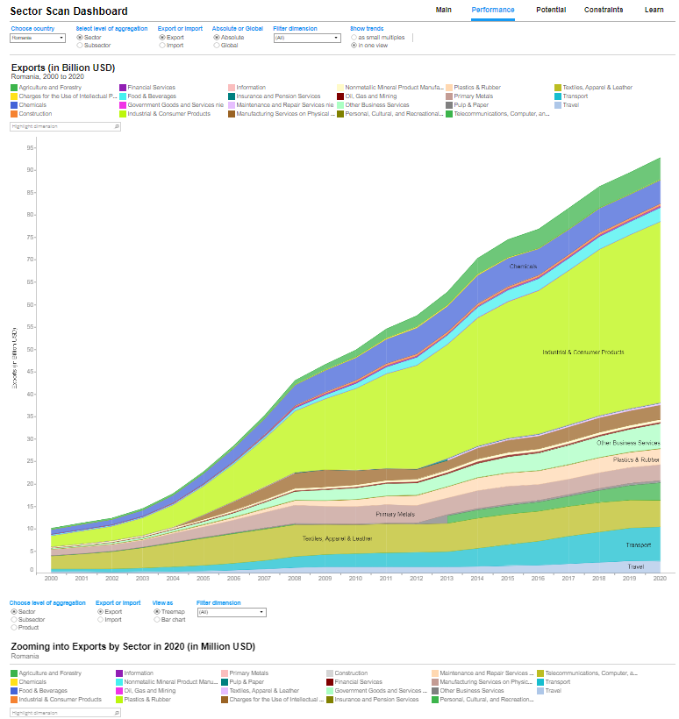
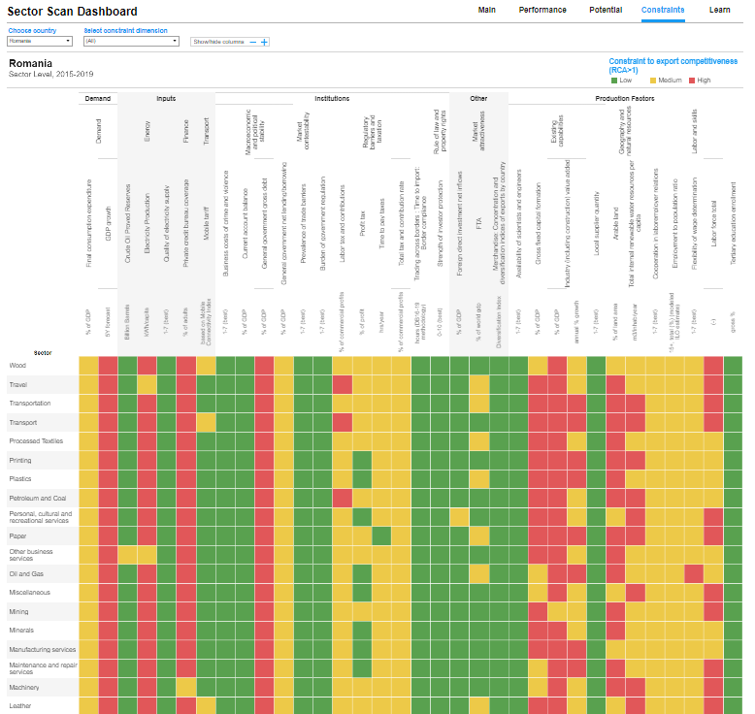
CPSD Sector Scan Dashboard
Objective:
A dynamic and interactive tool to allow CPSD TTLs to scan, review, and identify tradeable sectors (both goods and services) that may present opportunities for private investment to transform or create markets.
Content:
Although designed for CPSD TTLs, the content is also helpful in preparing for CCDR consultation and drafting IFC inputs.
The Sector Scan has currently three dimensions: (1) Sector Performance: characterizing a country’s trade context; (2) Sector Potential: which sectors show promise? (3) Sector Constraints: what are a country’s constraints on export competitiveness at the sector level?
Relevant green indicators, examples: CO2 emissions per capita per sector, CO2 intensity of gross exports by sector, % of products traded in green value chains, % of products traded with environmental benefits
Status:
Beta version of the Tableau dashboard is available online.
Data available through 2020.
IFC ECONOMICS CCDR WORKSHOP JULY 2022

Slide 9
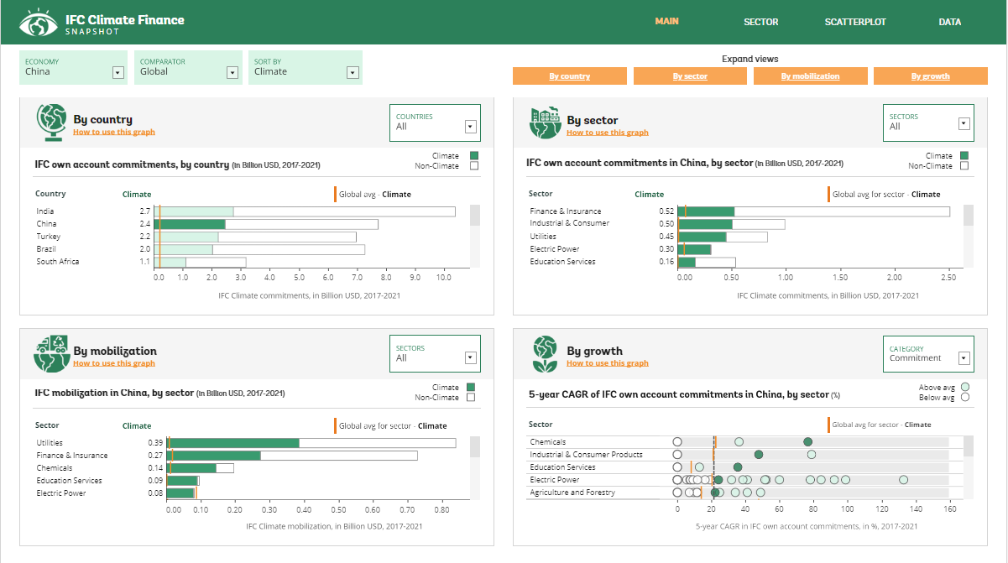
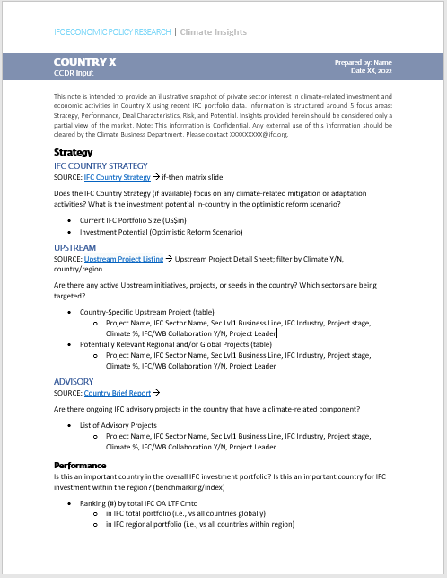
IFC Climate Finance Insights (working title)
Objective:
To provide an illustrative snapshot of private sector interest in climate-related investment via evidence-based insights drawn from IFC’s climate finance commitments and mobilization.
Content:
IFC climate finance and mobilization over time, benchmarked by sector, country, and region.
Deal characteristics and curated insights on key success factors.
Integrated data from across IFC departments and tools, including: Corporate Strategy, Upstream/IS/AS Portfolio, Development Impact, Risk, and Potential.
Status:
IFC-only Tableau dashboard nearly complete.
Additional non-IFC FDI data being considered for integration.
Output to be developed for two pilot countries (Turkey, one other TBD).
IFC ECONOMICS CCDR WORKSHOP JULY 2022

Slide 10
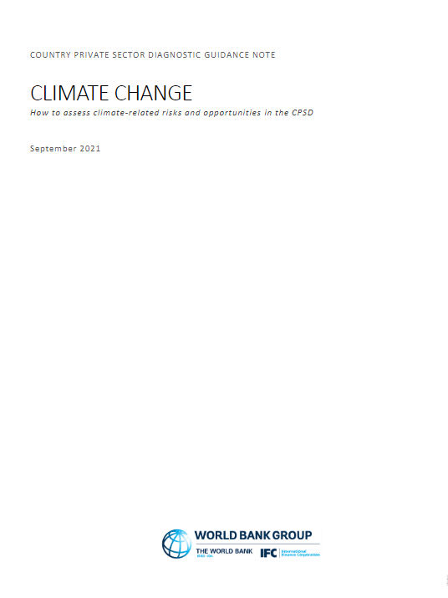
CPSD Climate Methodology Guidance Note
Objective:
The primary objective is to help TTLs integrate climate into the CPSD concept note and evaluate the importance of climate as a source of constraints on or opportunities for private sector development.
Content:
Although designed for CPSD TTLs, the content is also helpful in preparing for CCDR consultation and drafting IFC inputs.
Overview of climate change issues relevant to private sector development
Menu of reliable data sources, indicators, and other relevant references through 2021.
Status:
Guidance note is available online.
2022 update TBC.
IFC ECONOMICS CCDR WORKSHOP JULY 2022

Slide 11
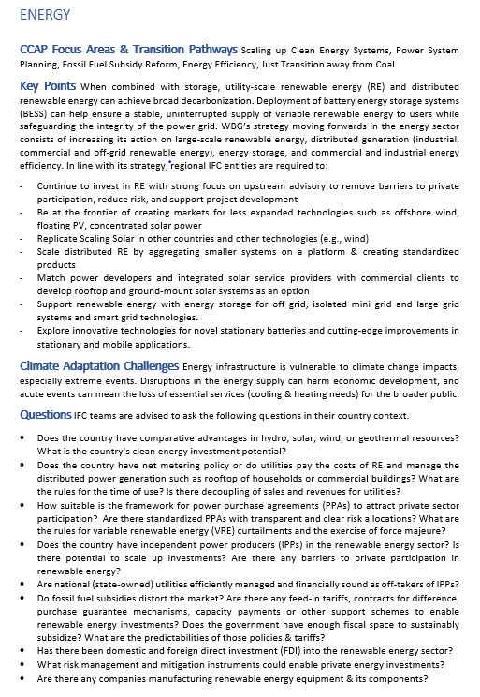
CCDR Private Sector Check List
Objective:
The CCDR Checklist is intended to assist IFC regional teams in bringing private sector perspectives to CCDRs, focusing on the key systems of the Climate Change Action Plan 2021-2025 (CCAP).
The objective is to identify climate-related mitigation and adaptation interventions that can be prioritized by the private sector over the next 5 years.
Content:
For each key transition system of the CCAP, such as agriculture or energy, the Checklist provides detailed information on CCAP focus areas, transition pathways, adaptation challenges, and guiding questions.
The Checklist Annex provides a list of mitigation and adaptation activities, typical areas for private sector involvement during key system transitions, potential upstream and mainstream actions, IFC examples, CCAP guidelines specific to IFC and sector-specific sources.
Status:
Available on request.
IFC ECONOMICS CCDR WORKSHOP JULY 2022

Slide 12


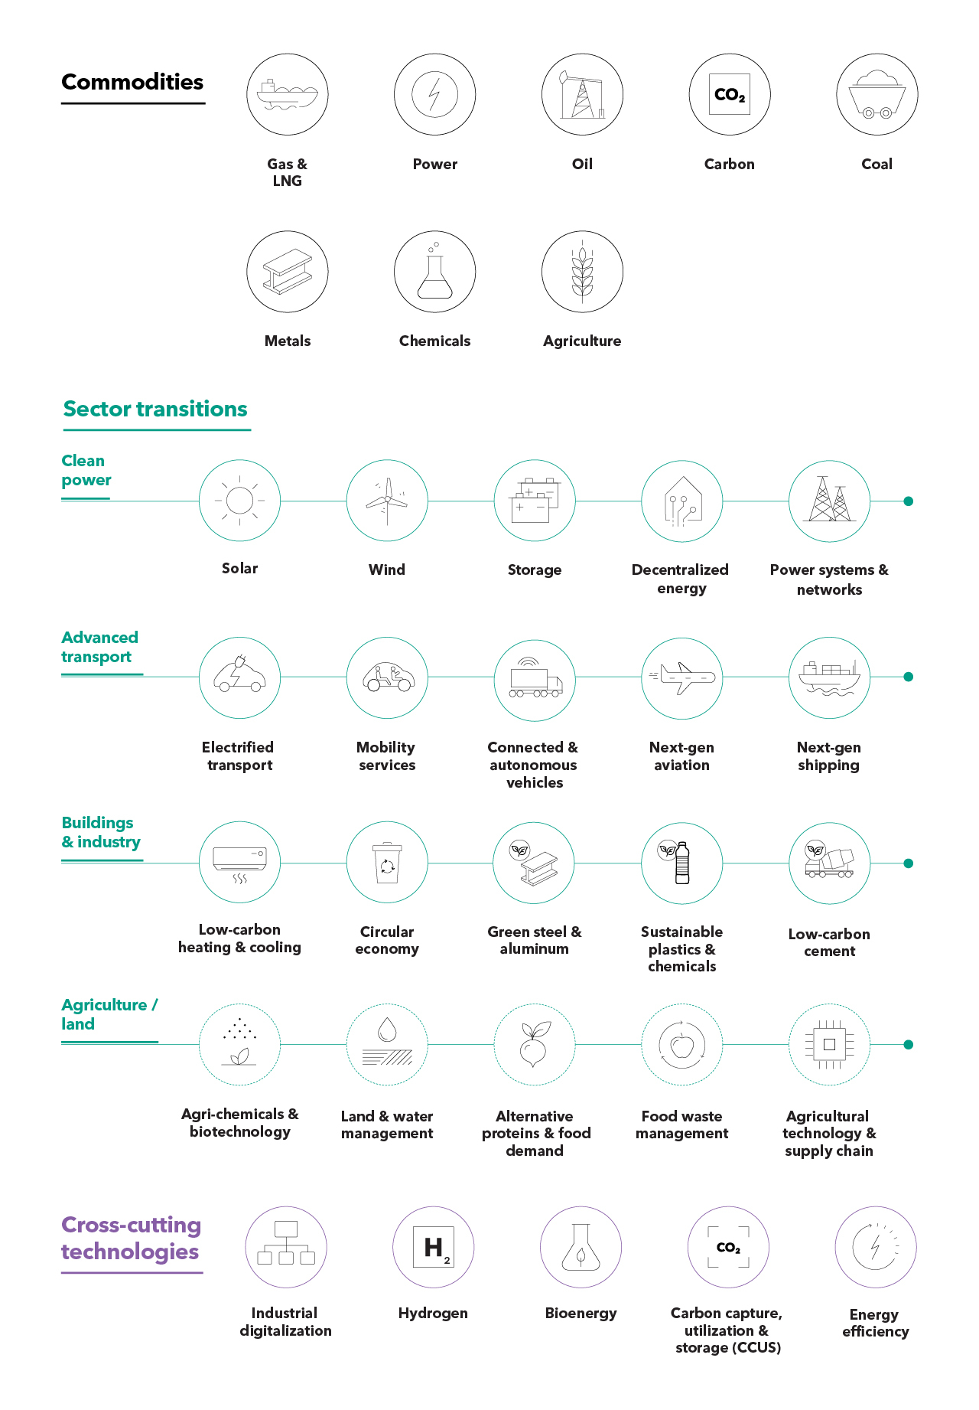




IFC Resources
Intranet:
Climate Business
Upstream Climate
CERCD Climate Resources
IFC Country Report Summary (BI Reporting)
Sector Insights (iPortal)
Internal Dashboards:
IFC Portfolio Explorer
Cross-Border Investment Tracker
CDI Jobs Dashboard
MALENA ESG Dashboard
IFC Subscription Services:
Fitch Connect => Moody’s, S&P Global
EMIS => EIU Country Intelligence, Oxford Economics
Verisk Maplecroft
FT’s fDiMarkets (available upon request)
Capital Economics (available upon request)
Ask our librarians
Click to explore
IFC ECONOMICS CCDR WORKSHOP JULY 2022

Slide 13
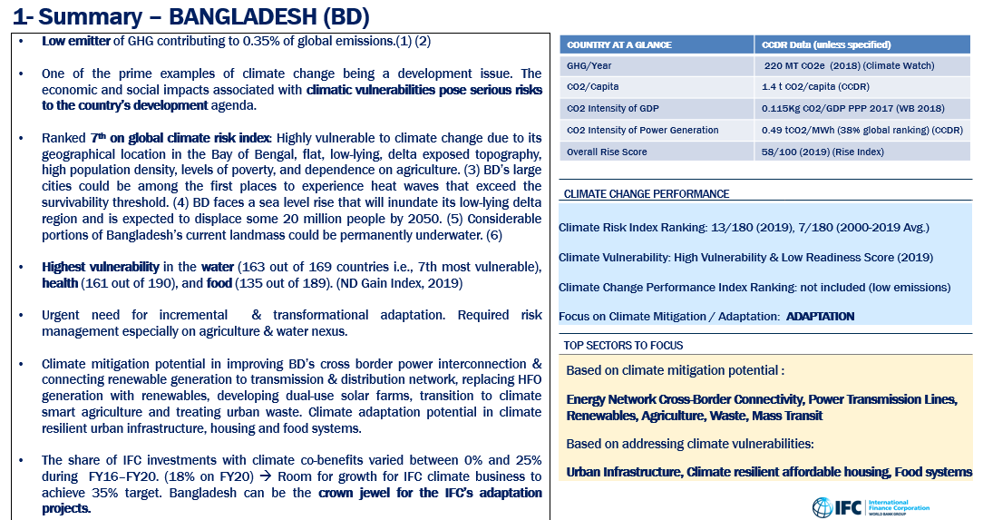
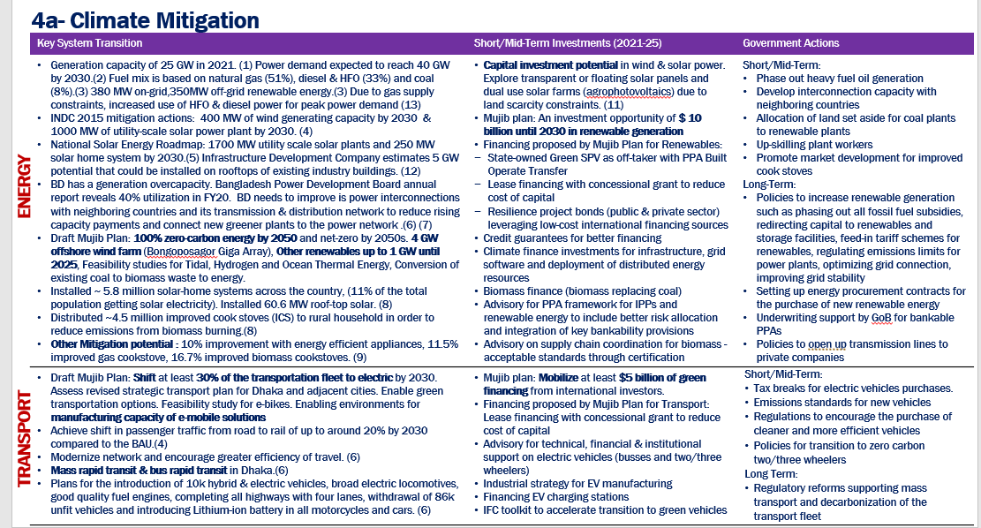
Climate Business Opportunity Snapshot
Objective:
Provides potential climate business opportunities and typical enablers for private sector climate action, as well as interventions IFC entities could explore.
Content:
For each specific country: Climate Change Context, GHG Emissions, Climate Mitigation & Adaptation Investments and Government Actions, Climate Finance, IFC Existing Climate Business, NDC Mapping vs IFC Business, IFC Climate Business Potential & Risks.
Status:
Drafted for South Africa, Indonesia, Bangladesh, Turkey as an example.
IFC ECONOMICS CCDR WORKSHOP JULY 2022

Slide 14
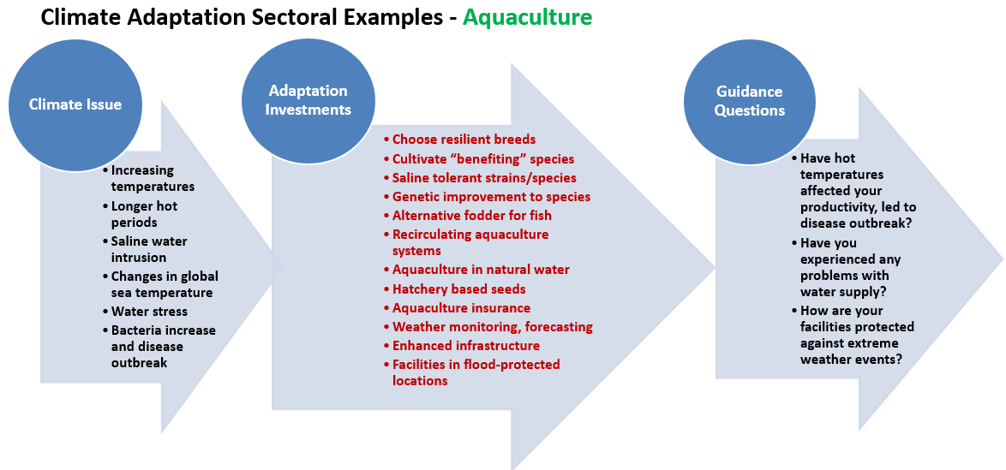
Climate Adaptation Snapshot
Objective:
Explore potential interventions and typical enablers for adaptation investments and actions for specific sectors in a country for IFC entities to identify potentials for private sector involvement.
Content:
Content created based on information provided by CBD.
For selected sectors/subsectors (such as aquaculture, crop production, buildings): Specific Adaptation Issue, Adaptation Investments, Guiding Questions.
For specific countries: Country Specific Climate Adaptation Context, National Climate Adaptation Policy, Focus Areas and Adaptation Finance Needs.
Status:
Drafted for South Africa as an example.
IFC ECONOMICS CCDR WORKSHOP JULY 2022

